Slide 1
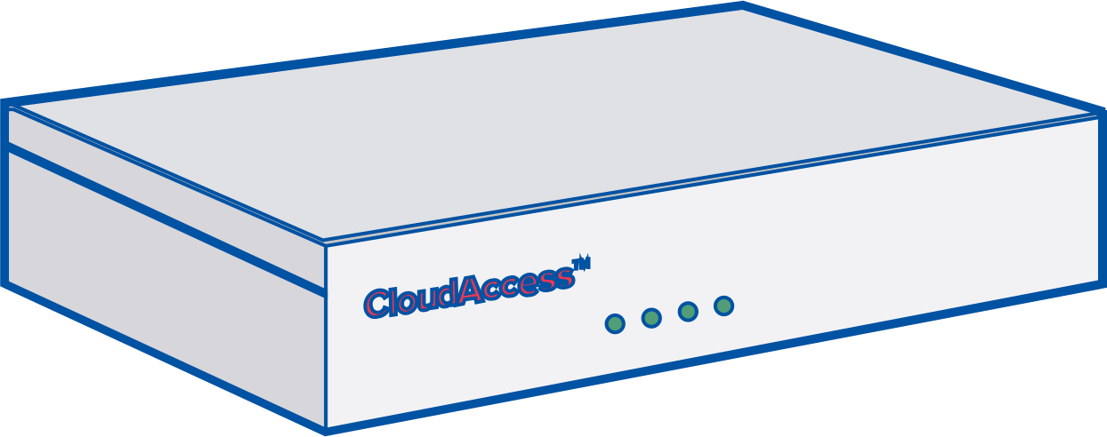
Always-On Restaurant with Failover
Internet
HD WAN™ is a solution for organizations that absolutely have to be online.
Our newest product allows customers to combine their wireline connection with a wireless connection to give them an unbreakable connection to their cloud-based applications.
We now offer seamless LTE wireless back-up for a constant connection so you can focus on what truly matters - serving your customers.
Ask us how you can protect your business with our managed LTE back-up solution.
ISP
ISP
Features Included
Seamless transition from primary to standby connections.
Throughput and usage caps to help you avoid overage charges.
Bring your own links and we’ll do the management.
Learn more
contact@hdwan.technology
www. hdwan.technology/my-business/

