Slide 1
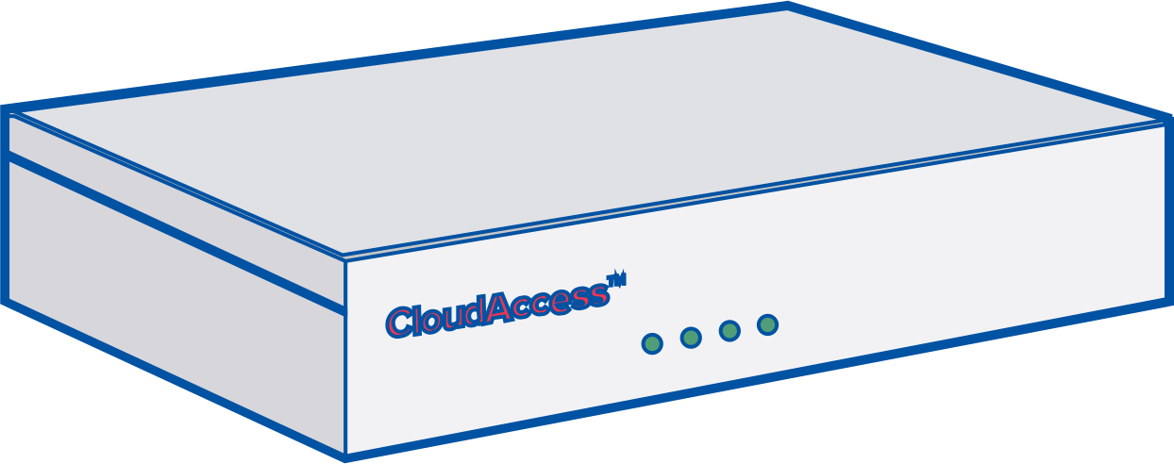
Need More Bandwidth?
How remote and rural organizations can combine Internet connections to create a faster virtual connection.
Today’s organizations are struggling to keep up with the exploding pressures the Internet is putting on their networks. Slow Internet can cause delays in your daily activities, which can cost you time and money. If you're experiencing perpetually slow Internet connectivity, we can help.
Our newest product, HD WAN™, allows you to combine multiple low-cost Internet connections to create a faster link. The technology supports virtually any broadband connection, and is fully managed, giving you peace-of-mind.
Internet
ISP
ISP
Learn More
contact@hdwan.technology
www. hdwan.technology/rural-internet

