Slide 1
More Remote Workers Means More Strain on the Office Internet Connection.
Even though the desks are empty, accessing on-premises applications and tools requires more bandwidth – and higher availability – than ever before. It’s time to consider how your network is going to support the “new normal”.
Work from Office
The Client – A boutique architectural firm with 40 employees charging billable hours.
The Problem – Where internet access bandwidth needed only to support email, web traffic, the odd conference call and a few remote users accessing on-premises applications and files, Covid-19 has turned the head office into a Data Centre – and the office’s internet connection couldn’t keep up.
When Covid hit, this architecture firm client focused on enabling employees to work from their homes. Each employee was given VPN access and some brought their work machines home. But one oversight meant that those employees would now have to access on-premises applications through a VPN, over the public Internet, and by way of the office’s internet connection. The need for VPN licenses was addressed, but the need for sufficient bandwidth to support those VPN licenses hadn’t been considered.
Simply put, the office’s connection couldn’t handle the “new normal”.
Work from Home
Doubled upload capacity for employees working from home via VPN.
Mixing connection types meant improving network reliability.
Improved employee experience and productivity.

Slide 2
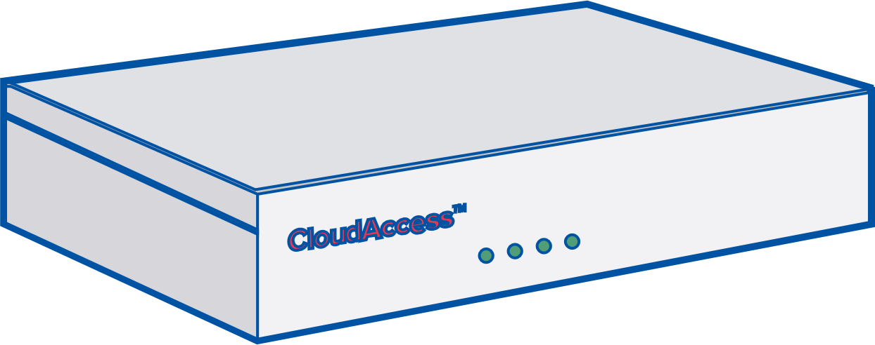
Your Upload…
…is Their Download
The Internet
Office Servers
Employees At Home
Consider your office’s upload bandwidth, as it’s now impacting your employees’ productivity.
As employees were downloading working files onto their local machines, the office servers had to upload those same files. The client had to quickly ensure the office’s upload bandwidth was sufficient to support all of those requests.
The trouble was that what the firm really needed was a significant increase in upload capacity. Their existing cable connection had an upload capacity limit of 20mbps increasing their download wasn’t going to help and their provider didn’t have any other way to give them the necessary bandwidth.
The Solution: HD WAN.
The client chose to combine the bandwidth of multiple broadband connections at their head-office with HD WAN.
The solution was to add two 50mbps DSL lines that each had 10mbps of upload capacity to their existing 500mbps cable internet connection that itself has an upload speed of 20mbps.
The client, then, in short order, was able to provide their employees with 40mbps of upload capacity.
With HD WAN, the customer was able to quickly address their need for upload capacity to support their now, largely, distributed workforce, who, themselves could download and use files more efficiently.
Internet
DSL
DSL
Cable
HD WAN
Find out how HD WAN can help you, contact:
Copyright © 2021 HD Telecom Inc. All rights reserved. This product is protected by Canadian and International intellectual property laws. For more information on use of this material , logos, wordmarks, and trademarks, visit: http://www.hdwan.technology/terms RMCS-AUG-2021

