Slide 1
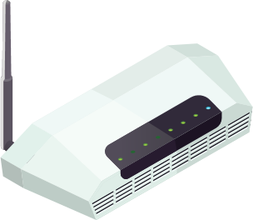
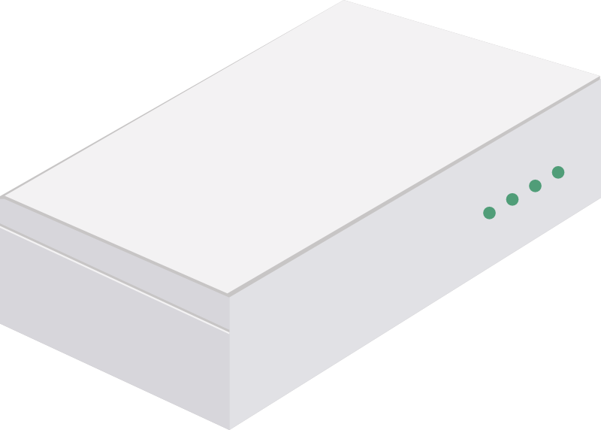
Ultimate Connectivity for Small Business and Home Office Productivity.
Our newest product provides small businesses and home office users with more bandwidth, unbreakable connectivity and clear voice & video streaming.
Bonded Internet Connections - More Bandwidth
Using our technology to bond Internet connections is the easiest and most affordable way to scale network bandwidth. Combine Cable + xDSL + Fiber = Full Sum Aggregation of Download and Upload.
Backup Internet Connections - No More Downtime
By strategically combining multiple Internet connections from different networks or carriers, HD WAN delivers more uptime than just a single connection. The system recognizes network outages and re-routes traffic instantly to back-up or standby connections, avoiding network disruptions to keep business going.
Quality of Service – Quality Voice and Video Streaming
This Quality of Service cleans up your broadband traffic by assigning bandwidth to top priority applications such as Zoom, Meets, Teams and VoIP while limiting other apps trying to hog your network. The result is crystal clear videoconferencing and VoIP calls despite all the network traffic.
Cellular Standby Connection
Primary Connection.
From
50
$
HD WAN
/Month

