Slide 1
Productizing HD WAN for Single-Site Deployments
12 products you can build, market and deploy today using HD WAN.

Slide 2
What can you do with HD WAN?
The Many Faces of HD WAN
This document outlines twelve different product offerings ISPs can put in their quiver to help their customers achieve network confidence.
Come partner with HD Telecom and we’ll help you unlock many more markets and opportunities to increase your share of your customers’ telecom spend.
Book a demonstration by visiting us online:
https://www.hdwan.technology
Always-On Networks
Business customers are moving applications to the Cloud, adopting SaaS for marketing, sales, operations, finance and many other critical business functions.
Give your customers increased uptime so that their network isn’t what they’re worrying about.
2. Improving Existing Connectivity
These days, business customers are looking to maximize the efficiency of their networks. Use HD WAN to deliver traffic prioritization as well as overall network management and monitoring so your customer can rest assured that their network is supporting the various online activities of its users.
Mobile Broadband Products
Cashless transactions are the new normal for businesses operating on-the-go.
Provide static-IP, multi-LTE solutions so customers have sufficient bandwidth and near-perfect uptime.
Fibre Alternatives
Just like a decade ago, connectivity is going through a major overhaul. Where ten years ago, businesses were moving from DSL to Metro Ethernet, today they’re moving from 20mbps vDSL to Fibre - with no options in between.
Create an option for customers to increase bandwidth at a price-point they can afford.

Slide 3
The UN-DOWN-ABLE Internet
Customers, especially business customers, rely more and more on Internet-based (or any off-premises) applications and services.
Internet reliability still makes them anxious.
By combining diverse Internet connections, downtime drops from over an hour per week (99.1% uptime) to less than one minute (99.99% uptime).
These products primarily use LTE as a back-up, but any diverse connection would yield similar results.

Slide 4
1. DSL w/ LTE Back-Up
This is the Bell “Wireless Backup” killer.
Simply deploy HD WAN, a DSL and an LTE and you've got a product you can take to the small business market. Bell will sell this product in Canada for between $45 and $105 on top of an existing Bell service.
You can undercut if you want, or, because your failover product is now session-persistent (same-IP address for both connections), you can add a premium and improve your margins. Oh, and they sell a hardware device for $500 - so you can match that price and make another $100. Sell these guys all day.

Slide 5
2. CABLE w/ LTE Back-Up
Rogers has been pushing their Rogers Business Internet – Pro™ with LTE for Small Businesses pretty heavily lately. The trouble again is that the failover from the business cable connection to the LTE won't sustain a voice call.
What's more, Rogers will have no quality of service mechanism to detect or remediate if latency spikes, making connectivity sub-par. Get in the small business game with an LTE failover package for Rogers Cable (or any Cable Connection, for that matter).

Slide 6
3. Fibre with LTE Back-Up
Some customers in well-populated areas can get 1Gbps for less than the average cost of a 100Mbps connection. They’re the lucky ones.
But fibre does also go down. With HD WAN, you can deliver that 1Gbps connection to the customer and back it up with LTE, too.
We call it network peace-of-mind.

Slide 7
4. Fibre with Bonded Broadband Back-Up
For some customers, however, backing up a Fibre connection with an LTE is a costly solution.
In that case, HD WAN can be configured to support multiple standby-links and bond their bandwidth separately from the Fibre connection. As such, your customer could have multiple broadband connections acting as a bond that is sitting idle, prepared for the untimely event of a fibre cut.
That’s Network Confidence.

Slide 8
5. On-Net DSL and CABLE, Bonded
As an ISP, when you have diversity in your on-net connectivity, you're in the driver's seat for SD-WAN. When you consider that you have the network, the NNIs, the IP addressing, the support systems and the diverse connectivity - there's little else you need.
SD-WAN vendors who run their own networks (pureplay vendors like VeloCloud) will charge customers a per-megabit price ON TOP OF the cost of the network connectivity.
With HD WAN, you can easily charge a set price – and sell SD-WAN as a simple add-on for every deal. It's all profit.

Slide 9
Adding Value to Existing Connectivity
If customers aren’t going to be doing much in the way of business travel over the coming months, they should add a layer of performance to their existing network connection.
To support video conferencing applications, a service provider can deploy HD WAN to monitor and manage traffic to and from the Internet.
Provide added value to existing customers. Let them know they can upgrade their existing connection with HD WAN – give them clean bandwidth.

Slide 10
6. Managed Broadband
Want to simply and affordably add a layer of management to your broadband connectivity? Deploying HD WAN is a quick way to get valuable insight into network performance, automate alerting, and make the case to upsell/cross-sell onto other products and services.
Not only that, but you can now add monitoring for customers on someone else’s network. Quickly and easily increase performance (see our next page), put their customers on your IPs and monitor and manage 3rd party connectivity.

Slide 11
7. Clean Broadband
In the post-Covid Era, face-to-face meetings will be conducted far more commonly over the Internet. Your customers' connectivity will start to reach its limits. Use HD WAN’s traffic management features to prioritize voice and video application streams over bulk traffic like email/websurfing.
Introduce a package that cleans up their bandwidth and gets them ready for the new normal and see how many of them bite. Moreover, with work-from-home options abound, guarantee your customers' employees' networks won't "lose the deal" on account of poor video/voice quality. Can you hear me now?

Slide 12
On the Move, In the Groove.
LTE can be a valuable asset to any business.
When your customers are on the move, HD WAN can keep them connected. By combining multiple LTE connections, your customer has nearly unlimited capabilities while on-the-road.
Whether it’s Taxi Cabs, Food Trucks, Pop-Up Stores/Services, or farmers’ markets, a multiple-SIM solution can open up a lot of opportunities – for both the service provider and the customer.

Slide 13
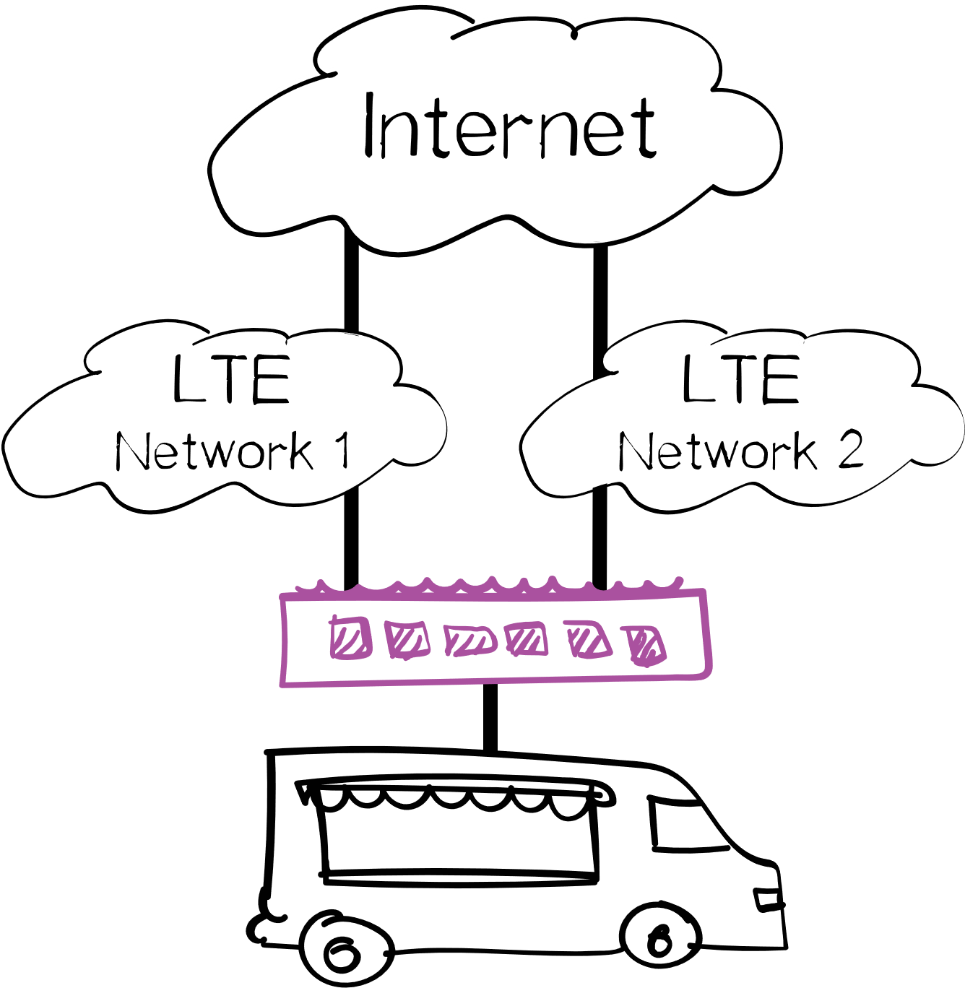
8. Static-IP Bonded LTEs
LTEs are notoriously inconsistent and while bandwidth may be fast in some areas, it may not be in others. FoodTrucks and Farmers’ Markets will be looking for mobile broadband solutions to support cashless transactions as Covid-19 changes the way they do business. And they'll be busy. Which means there'll be more of them.
Which means you've got to get out there and find out how to put a dual-SIM, single-IP solution in their hands to show them how reliable the network can be.
And while you're at it, why not mix-and-match carriers? (That’s #9)

Slide 14
Alternative to Fibre
In less populated areas, fibre can get pricey. And waiting for fibre to get to some locations can be painful. Your customers need to do business now.
Using HD WAN, you bond the bandwidth of multiple connections to deliver fibre alternatives using Cable, DSL, Fixed-Wireless as the underlying transport.
Moreover, HD WAN can support multiple gigabit speeds, allowing you to bond two or more fibre connections for high-bandwidth customers.

Slide 15
10. Fibre Alternative – Bonded Cable
Most wholesale Cable Internet connections in Canada have an upload limit of 20Mbps. If a customer needs more than 20Mbps, the next option is fixed-wireless (if they've got it) or fibre (if they can afford it).
HD WAN can help customers that are hitting the 20Mbps ceiling. You can bond two (or more) Cable connections for greater upload capacity for your customer, then clean it up using QoS, and provide pro-active monitoring and management?
Fiber-like speeds at broadband prices? Yes, please.

Slide 16
11. Fibre Alternative – Bonded vDSL
Often times, customers choose fiber because there are no other options. As we just read, when upload speeds are limited and your customer needs more, they have very few options available to them.
HD WAN allows you to create a product that delivers 250mbps x 50mbps - managed, with QoS, encryption, latency, jitter, and packet-loss avoidance for sub $200/month. Yes, it's possible.

Slide 17
12. Multiple Fibre Connections
Lastly, for those customers with a need for bandwidth greater than 1Gbps, HD WAN can be used to combine multiple fibre lines.
For customers needing lightning fast networks, HD WAN is the answer.
On a simple Intel™ Core® i7 processor, HD WAN can achieve over 2.5Gbps, making it one of the fastest, most CapEx-friendly products on the market today.
Give your customers a product that will scale with them.

Slide 18
What can’t you do with HD WAN?
There’s not much you can’t do with HD WAN.
Deliver more value to customers and support customer needs for faster, more reliable, and clearer online communications.
HD Telecom promises a very fast Return-on-Investment (day one in some cases), no upfront fees, no volume commitments, and a scalable product that is simple to deploy and support.
Book a demonstration by visiting us online:
https://www.hdwan.technology
© 2021 HD Telecom Inc. and/or its affiliates. All rights reserved. HD WAN is a registered trademark of HD Telecom Inc. and its affiliates. This publication may not be reproduced or distributed in any form without HD Telecom's prior written permission. It consists of the opinions of HD Telecom's research organization, which should not be construed as statements of fact. While the information contained in this publication has been obtained from sources believed to be reliable, HD Telecom disclaims all warranties as to the accuracy, completeness or adequacy of such information. HD Telecom prides itself on its reputation for independence and objectivity. Its research is produced independently by its research organization without input or influence from any third party.
For more information, visit hdwan.technology/terms

